Slide 1
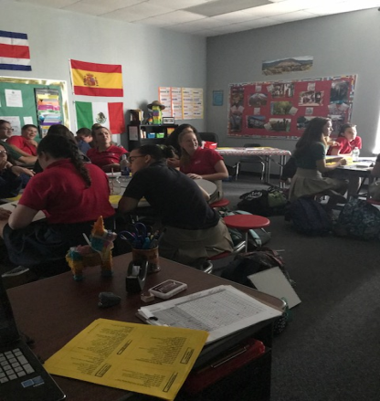
Bienvenidos a la clase de Profe Shafer!
Welcome
Parents and students, I first want to take a moment to say thank you for making the first two weeks a success! We have already covered so much in the last two weeks and I hope to continue this momentum going forward.
I would also like to extend a big thank you for all the families and students who have helped our class greatly through donations and your kind words. It means a lot and we are so appreciative for your support!
Highlights
Dates and other info:
Over the last few weeks, we have focused on learning basic vocabulary to help lay a foundation for our students. We have been able to cover introductions, pets, and have recently begun a unit on Identify – where it is my hope to increase our conversational Spanish skills in the coming weeks. Students have been enjoying all our vocabulary games such as Quizlet, and they especially seem to love Bingo! These games have helped students gain that foundation that will help them be successful in the future with the language.
Looking forward – Now that we have laid a foundation, it is my home to increase our Spanish use in the classroom this week. We have been around 50%, but it is my home to aim for 70% this week so we can get to our target of 90% by progress reports. We are well on our way!
Dates:
Map Quiz – 8/7
Tarea Semanal – 8/9 (every Wednesday)
Sr. Wooly – 8/11
Assessment on Identity Unit – 8/17 (tentative)
Classroom Needs:
Colored Copy Paper
Quizlet Vocab Set Links:
Quizlet.com/Clyde_Shafer
(Identity, animals, Intros pt. 1 and 2)
For Parents:
Join Remind to stay connected!
See the attachment emailed to find out how to join!
Working with Botero…
In addition, we have worked on creating cultural competicies. Last week, we did a blind drawing of art work from Fernando Botero. These turned out so amazing! Check out some pictures from this activity on our “student work” page of our classroom website.
Our classroom website is being updated! Go to profealpaca.weebly.com to see some cool student work and follow us for more updates!
Para conectar…
Email: cshafer@eastwakeacademy.org
Class Webpage: profealpaca.weebly.com
School Phone Number: 919-404-0444 ex 1052

